Slide 1






ARTIFICIAL INTELLIENCE SPECIALIZATION
Tech Skills Accelerator
LINEAR REGRESSION MODEL(SALARY DATA)
Gbenga Raji

Slide 2
0
Project Overview
SALARY PREDICTION: EDA, Model Development, Performance Evaluation
TESA
Artificial Intelligence

Slide 3
PROJECT OVERVIEW
Project Goals and About Dataset
Project Goals
To accurately predict the expected salary to be paid to an individual in his/her field. The objectives of this project include:
To ascertain the attributes that affect an individual’s salary using Exploratory Data Analysis
To develop a linear regression model that predicts an individual’s salary.
To evaluate the linear regression model using root mean squared error
About Dataset
The dataset used in this project contains 1000 different instances of individuals, and 7 attributes for each individual, which include;
Education
Experience (Years)
Location
Job Title
Age
Gender
Salary ($)
TESA
Artificial Intelligence
3

Slide 4
1
Exploratory Data Analysis
Univariate Analysis| Bivariate Analysis | Multivariate Analysis
TESA
Artificial Intelligence

Slide 5
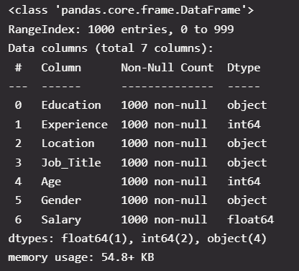
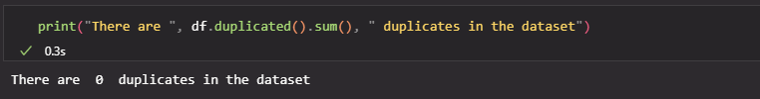
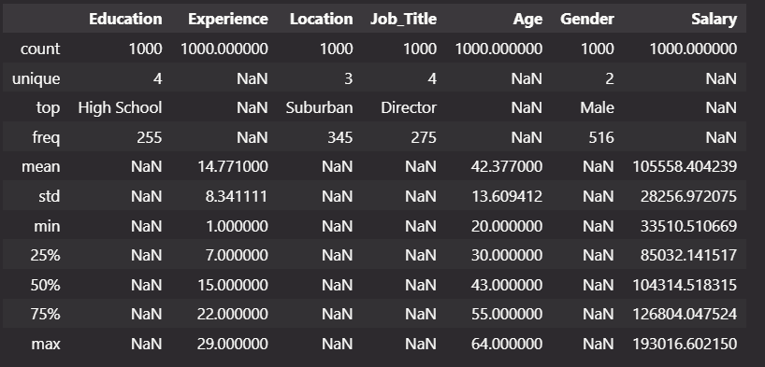
Exploratory Data Analysis
📌 Quick Observations
No missing or duplicate records were found in the dataset.
The dataset contains 4 unique education levels, with High School being the most frequent.
Experience ranges from 1 to 29 years, with the majority below 23 years.
There are 3 unique locations, with Suburban having the highest representation.
Among the 4 job titles, Director is the most common.
The age range spans from 20 to 64 years.
The dataset identifies 2 genders, with males making up the higher proportion.
Salary values range from approximately $28,000 to $190,000.
TESA
Artificial Intelligence
5

Slide 6
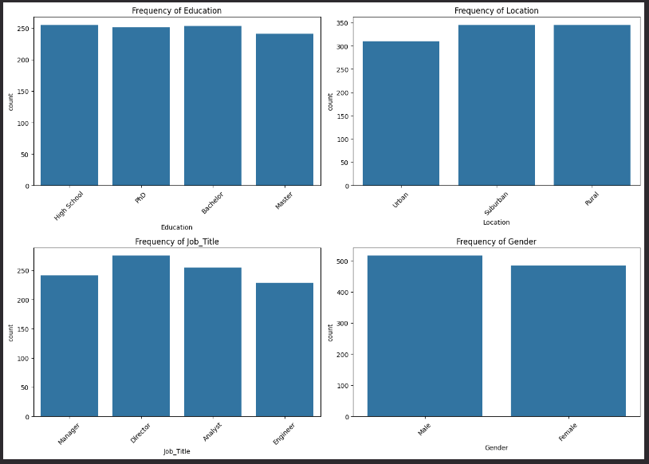
Exploratory Data Analysis
Univariate Analysis
Insight:
The distribution chart indicates that the dataset maintains a relatively uniform representation of categories across the Education, Location, Job Title, and Gender columns. This shows that the dataset is balanced, which helps minimise sampling bias during modelling.
TESA
Artificial Intelligence
6

Slide 7
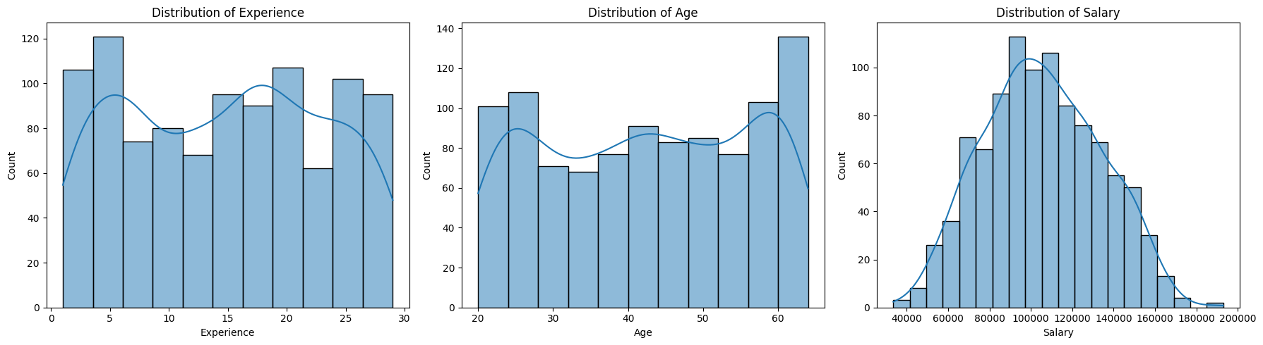
Exploratory Data Analysis
Univariate Analysis
Insight:
The distributions show that experience is fairly evenly spread with peaks at 2–5 and 18–21 years, age is bimodal with concentrations in the early 20s and late 50s to 60s, and salary follows a near-normal distribution centered around $95,000–$110,000 with most employees earning between $70,000 and $130,000 and a few high earners reaching up to $190,000.
TESA
Artificial Intelligence
7

Slide 8
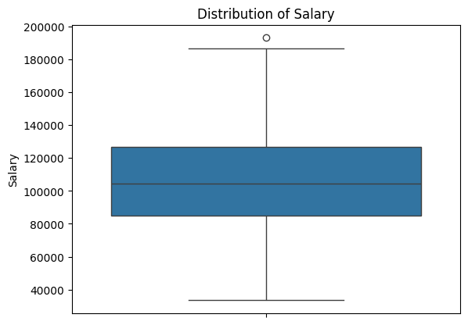
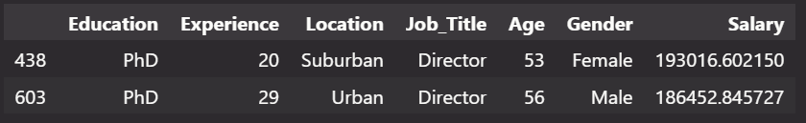
Exploratory Data Analysis
Univariate Analysis
Investigating Outliers
Insight:
The plot reveals a data point lying outside the whiskers of the box, suggesting the presence of an outlier. To determine whether this outlier is a legitimate observation or an anomaly, we examined records with salaries exceeding $180,000. The analysis shows that these entries correspond to individuals holding Director positions with PhD qualifications, indicating they are likely at the peak of their careers. Given their senior roles and advanced education, such high earnings are plausible. Therefore, this outlier is justifiable and does not warrant removal from the dataset.
TESA
Artificial Intelligence
8

Slide 9
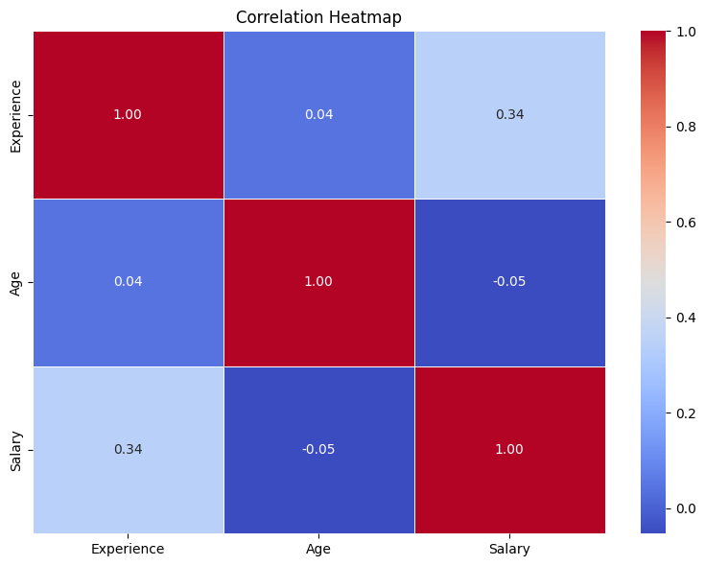
Exploratory Data Analysis
Bivariate Analysis
Insight:
The heatmap reveals a strong positive correlation between experience and salary, suggesting that as experience increases, salary tends to rise accordingly. In contrast, age shows little to no correlation with either salary or experience.
TESA
Artificial Intelligence
9

Slide 10
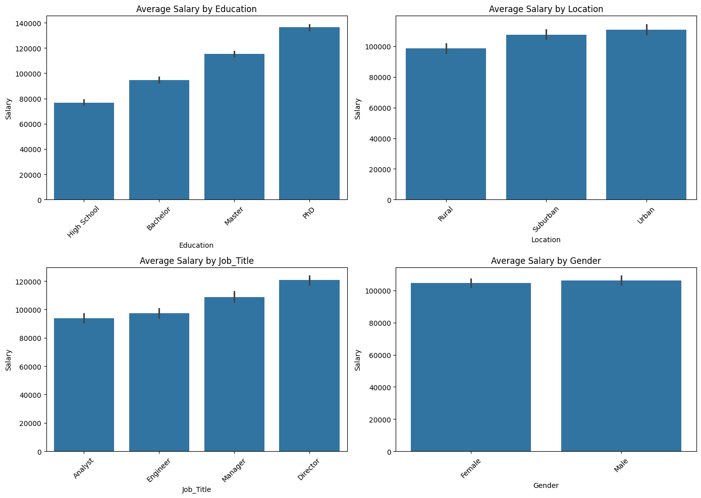
Exploratory Data Analysis
Bivariate Analysis
Insight:
There is a clear upward trend between education level and salary — the chart demonstrates that individuals with higher academic qualifications tend to earn more, highlighting education as a strong determinant of salary. For both location and job title, a similar progression exists; however, the differences in average salaries are not significantly pronounced, as the values remain relatively close. Lastly, gender appears to have little to no influence on salary, with average earnings being nearly identical across genders.
TESA
Artificial Intelligence
10

Slide 11
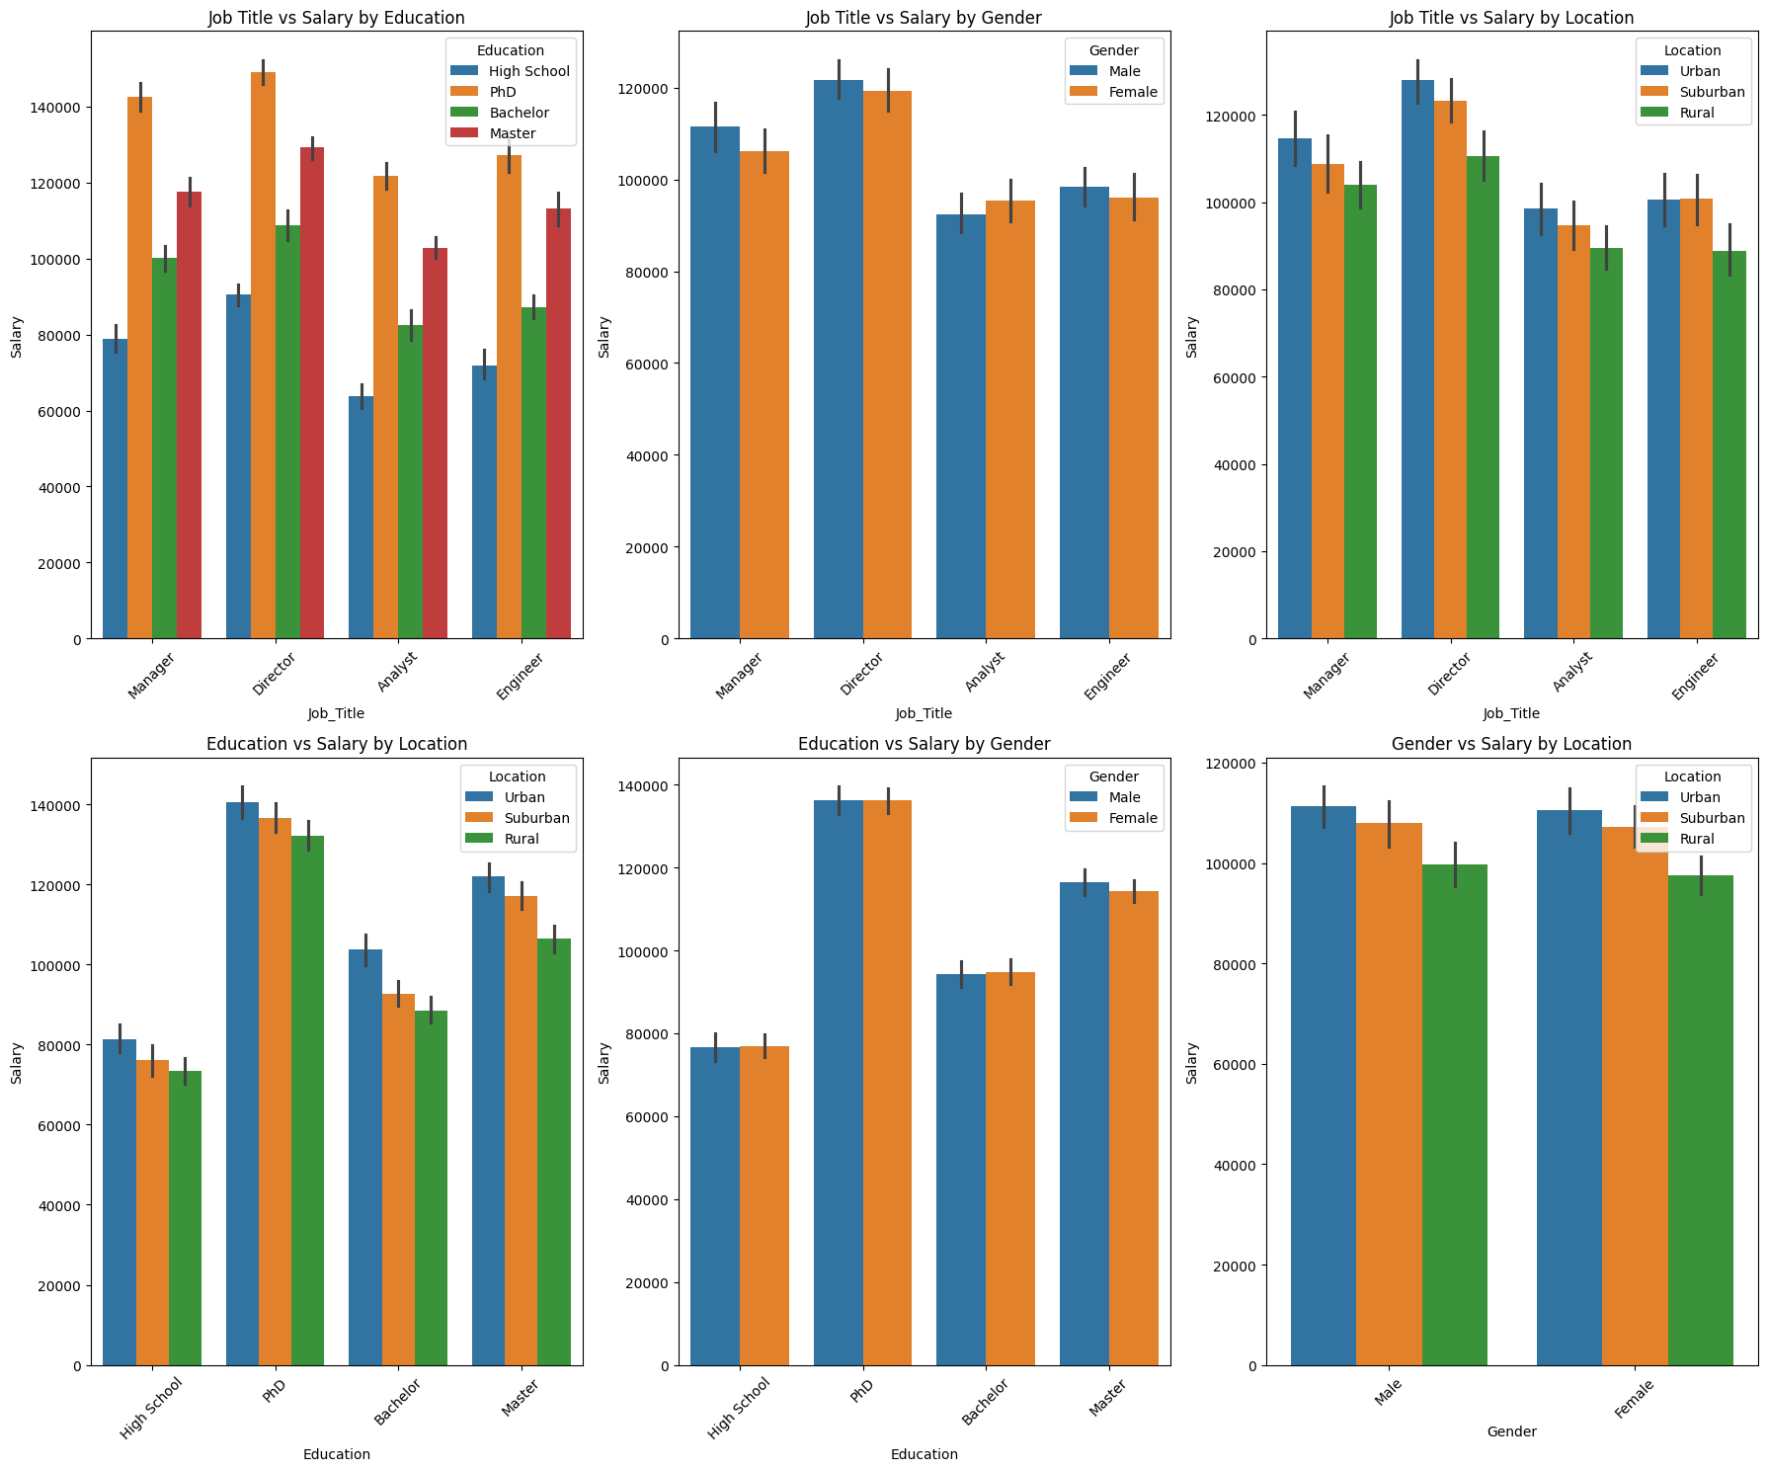
Exploratory Data Analysis
Multivariate Analysis
Insight:
All the subplots within the figure exhibit similar patterns across their axes, with one notable exception — the Job Title vs. Salary by Gender chart. For the roles of Manager, Director, and Engineer, males tend to have higher average salaries than females. However, for the Analyst role, the trend is reversed, with females earning a higher average salary than males.
TESA
Artificial Intelligence
11

Slide 12
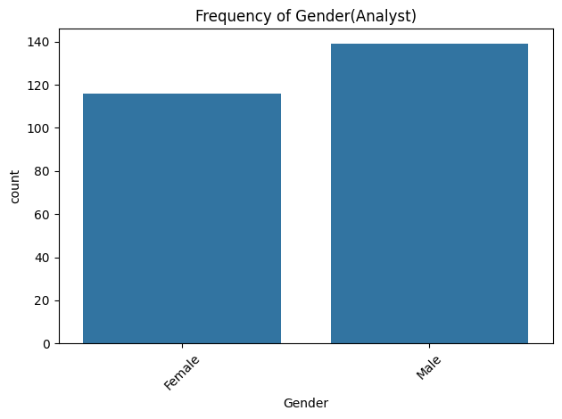
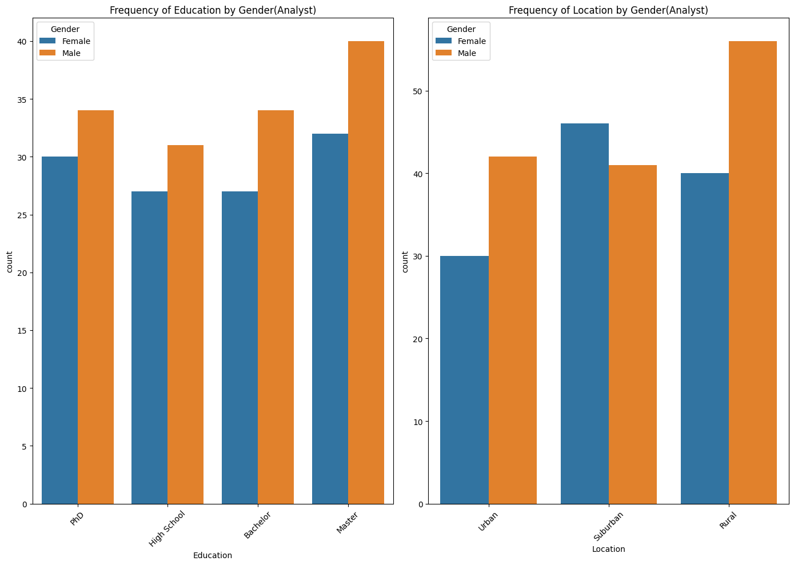
Exploratory Data Analysis
Analysis on Job Title - Analyst
Insight:
Notably, the charts show that the population of female analysts is smaller than that of male analysts, indicating that the higher average salary for females in this role is not due to population imbalance. Additionally, the distribution of education levels and locations among analysts does not provide a clear explanation for this salary difference.
TESA
Artificial Intelligence
12

Slide 13
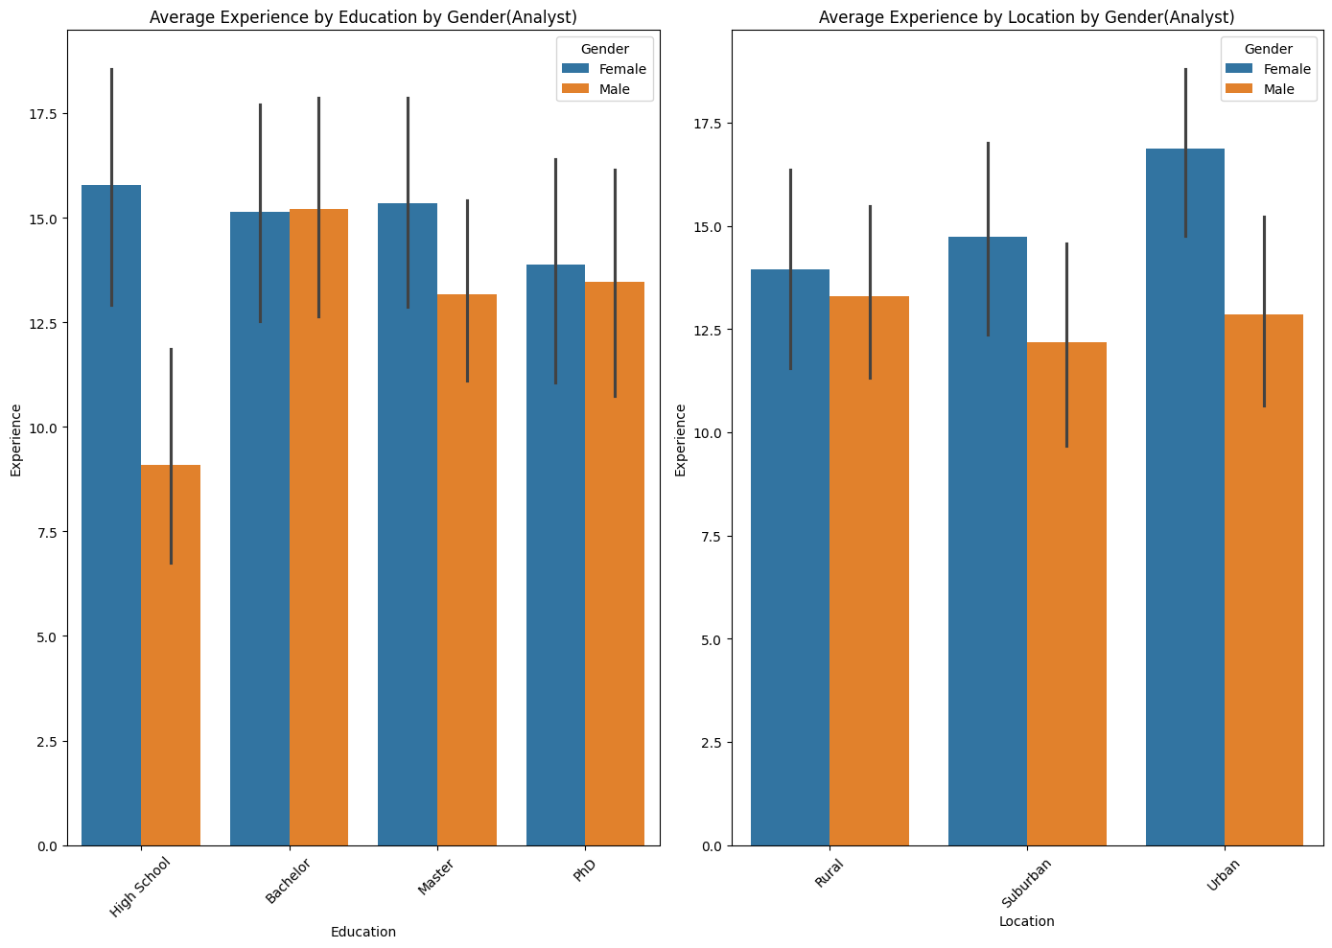
Exploratory Data Analysis
Analysis on Job Title - Analyst
Insight:
The chart shows that female analysts tend to have higher levels of experience compared to their male counterparts, regardless of their location or educational background. This suggests that experience plays a significant role in determining salary for the Analyst role. Therefore, it can be concluded that the higher average salary among female analysts is likely influenced by their greater experience, rather than differences in education, location, or gender alone.
TESA
Artificial Intelligence
13

Slide 14
Exploratory Data Analysis
📋 Summary
The analysis revealed several key insights:
The dataset is balanced and unbiased, with no significant issues in representation.
Both age and experience exhibit bimodal distributions, indicating distinct clusters of individuals.
Education level has a strong positive relationship with salary — the higher the degree, the higher the earnings.
Experience is also a strong determinant of salary, showing a clear progression in compensation with more years in the workforce.
There is a moderate relationship between location and job title with salary, though not as pronounced.
Gender and age, however, show little to no influence on salary, making them weak predictors in this dataset.
TESA
Artificial Intelligence
14

Slide 15
2
Model Development
Train, Val, Test Split | Feature Engineering | Model Training
TESA
Artificial Intelligence

Slide 16

Model Development
Train, Val and Test Split
To ensure robust model evaluation and prevent overfitting, the dataset was initially split into an 80:20 ratio, where 20% was reserved as the test set for final performance assessment. The remaining 80% was further divided into 90:10, allocating 90% for training and 10% for validation. This approach allows the model to learn from the training data, tune hyperparameters using the validation set, and be evaluated on an unseen test set, providing a reliable measure of generalisation performance.
Therefore, to ensure uniformity, a random state of 42 was used. At the end of the split, we have;
720 Train set
80 Validation set
200 Test set
TESA
Artificial Intelligence
16

Slide 17
Model Development
Features Engineering
🔧 Feature Engineering Summary
The following feature engineering steps were applied based on insights drawn from the exploratory analysis:
Ordinal Encoding for Education: The Education column was ordinally encoded because the education levels demonstrated a clear progression in average salary — higher academic qualifications consistently correlated with higher pay, making the order meaningful.
Creation of Gender_JobTitle Feature: A new feature, Gender_JobTitle, was generated by concatenating the Gender and Job_Title columns. This was specifically designed to capture hidden interactions, particularly the observed case where female analysts had higher average salaries, likely due to higher experience levels.
One-Hot Encoding for Categorical Variables: One-hot encoding was applied to Gender_JobTitle, Job_Title, and Location. These features were encoded this way because their unique categories did not exhibit significant ordinal relationships with salary, making one-hot encoding more suitable for preserving category distinctions without imposing order.
Exclusion of Age: The Age column was excluded from the modelling process as it showed no meaningful correlation with salary in the analysis, indicating low predictive value.
TESA
Artificial Intelligence
17

Slide 18
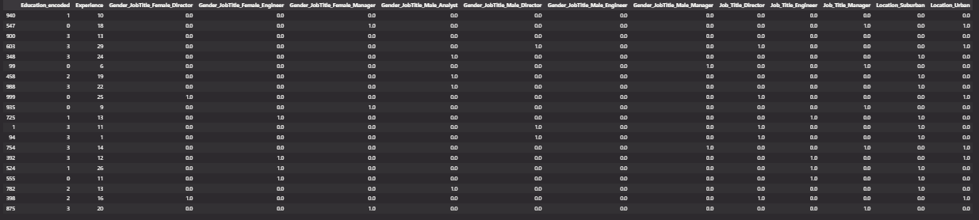
Model Development
Features Engineering
After successfully preprocessing the dataset, the resulting DataFrame contains a total of 14 columns, as reflected in the updated table.
TESA
Artificial Intelligence
18

Slide 19
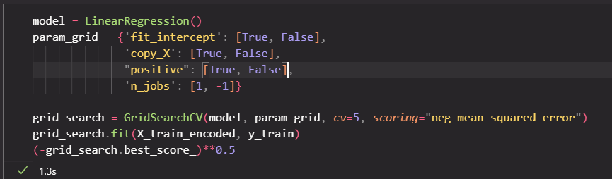
Model Development
Model Training
A Linear Regression model was used for developing the predictive model, and GridSearchCV was employed to tune hyperparameters and perform cross-validation, ensuring optimal performance and reducing the risk of overfitting.
TESA
Artificial Intelligence
19

Slide 20
3
Performance Evaluation
TESA
Artificial Intelligence

Slide 21
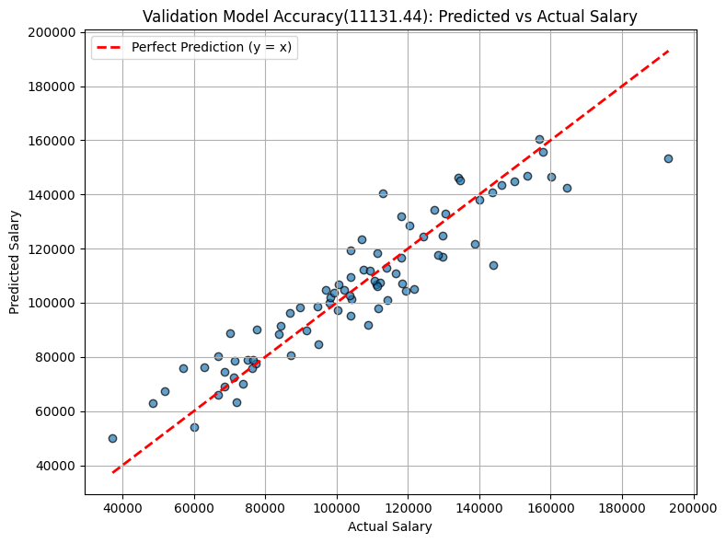
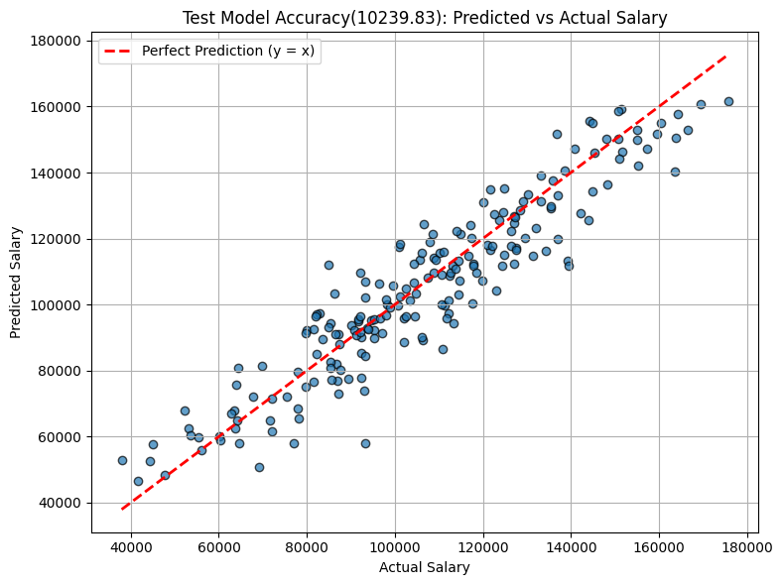
Performance Evaluation
The scatter plots above show the actual salaries (x-axis) versus predicted salaries (y-axis). Points closer to the red dashed line (y = x) represent more accurate predictions.
TESA
Artificial Intelligence
21

Slide 22
Performance Evaluation
📊 Model Evaluation Summary
The model was evaluated using multiple stages, and the results demonstrate consistent performance:
Cross-Validation (Training Phase): RMSE = 9,872.87
Validation Set: RMSE = 11,131.43
Test Set: RMSE = 10,239.00
These results indicate that the model generalises well and is not overfitting the training data. The close range of RMSE values across all stages suggests that the model maintains strong predictive accuracy, making it suitable and ready for deployment on real-world data
TESA
Artificial Intelligence
22

Slide 23
Conclusion
The project successfully explored and modelled salary data, identifying education level and experience as key salary drivers. After feature engineering and model development using linear regression, the model achieved strong performance with RMSE scores of 9,872.87 (cross-validation), 11,131.43 (validation), and 10,239.00 (test). These consistent results indicate that the model generalises well and is suitable for reliable real-world salary prediction.
TESA
Artificial Intelligence
23

Slide 24
Recommendation
To enhance this project further:
More diverse and comprehensive data can be collected to improve the model's accuracy and generalizability.
Future iterations could explore more complex models (e.g., ensemble methods) to capture non-linear patterns and improve performance.
The model can be deployed using cloud platforms or embedded into production systems to support real-time salary predictions.
TESA
Artificial Intelligence
24

Slide 25
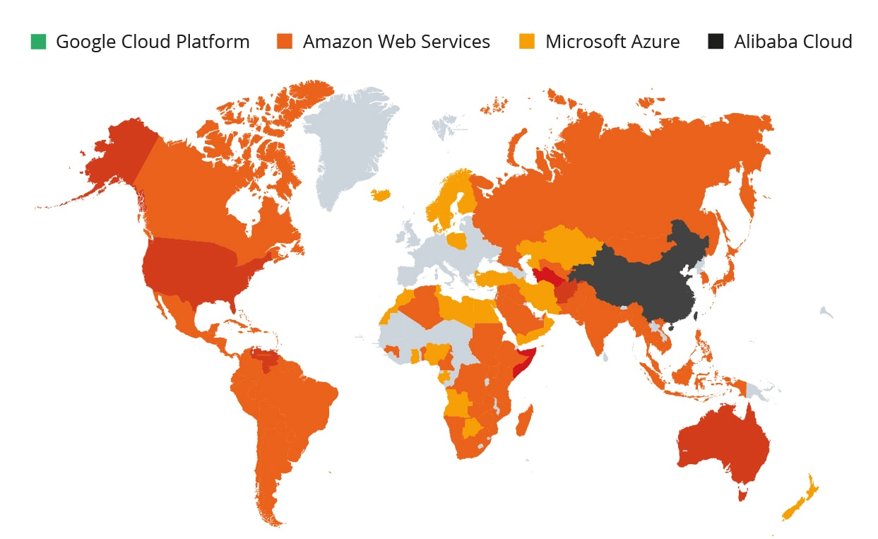






ABOUT US:
LOCATION. SERVICES
England
Canada
U S A
Dubai
QUCOON KEY SERVICES
Qucoon Consulting
Kenya
Qucoon Technology & Engineering Services
Nigeria
Qucoon Plus: Robotics, ML and AI
South Africa
Qucoon Digital Business
Qucoon Studios
Qucoon Cloud
Academy
25

Slide 26
Thank you.
TESA
Artificial Intelligence
26

